Slide 1
Account page Usability Testing Read Out
August 11, 2020
Julia Elman, UX Lead Ben Peterson, UX Designer

Slide 2
Agenda
Overview
Method
Design Studio process
Results
Next Steps
Notes:
I’ll quickly cover our process, what we learned and next steps.

Slide 3
1/ Overview

Slide 4
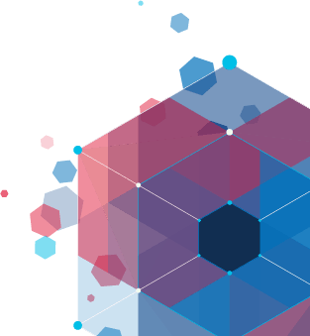
Purpose of study
To help End Users quickly update authentication methods and account information on their login.gov account.
Notes:
The purpose of this study was to help End Users quickly update account information and authentication methods on their login.gov account page.

Slide 5
Research questions
Can End Users understand what they can do from the login.gov Account page?
Can End Users easily navigate the page?
Can End Users easily find how to update their information?
Notes:
We wanted to know if End Users could easily understand, navigate and update their information on the account page.

Slide 6
2/ Method

Slide 7
Moderated usability testing
We used Moderated usability testing to gain a deeper understanding of what impressions End Users have when navigating through login.gov. We talk to them over videochat and watch as they use the site.
Notes:
To answer our research questions we did a mix of moderated and unmoderated usability tests. 12 participants completed the same tasks and answered questions about their experience on three variations on account page designs. Moderated means that we were speaking to them over videochat and watching them use the designs through a screenshare.

Slide 8
Unmoderated usability testing
We used Unmoderated usability testing to gain a deeper understanding of what impressions End Users have when navigating through login.gov on their own while responding to questions and reading a series of prompts.
Notes:
Unmoderated tests means end users recorded themselves going through the tasks on their own and we reviewed the video asynchronously.

Slide 9
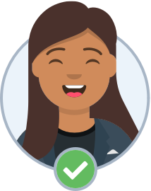
Participant criteria
12 participants.
5 female participants, 7 male participants.
9 unmoderated (people without a login.gov account.)
3 moderated sessions (people with a login.gov account.)
A range of income and ages
Average web users on a desktop device.
Located in the United States.
Notes:
Specifically we were looking for people who had a diversity of incomes , equal gender representation and people whose age matches the most frequent visitors of the account page - 25-35, 35-45 and 60-65+.

Slide 10
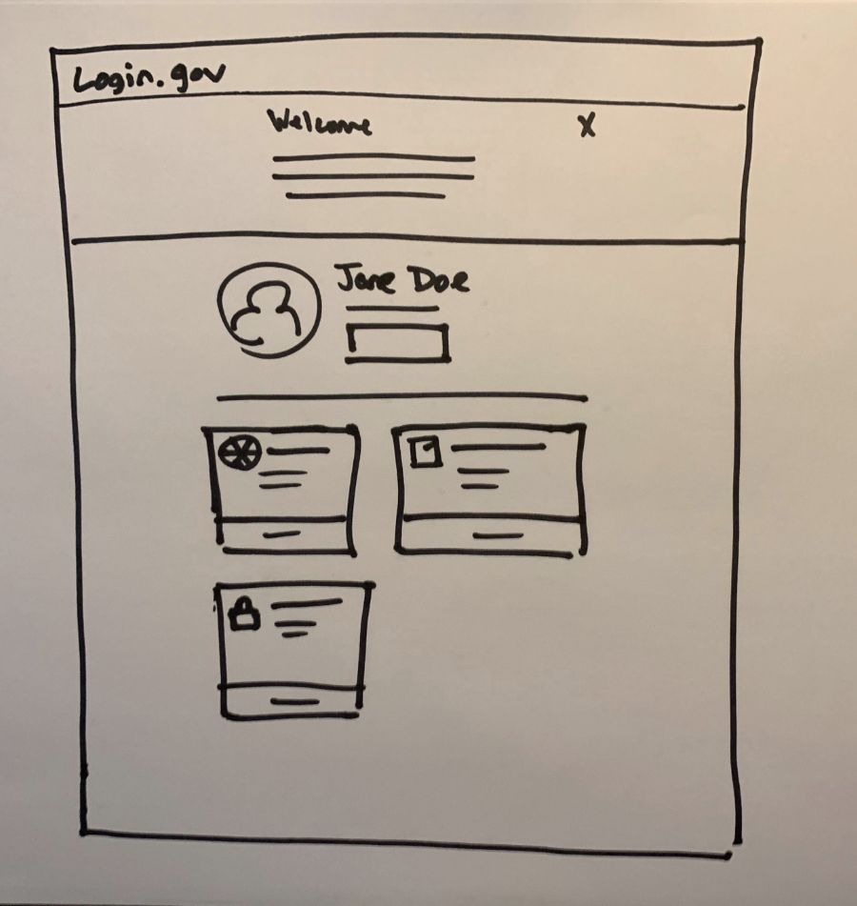
Design Studios
We used a sketching based brainstorming process to create a shared understanding of design problems and possible solutions to an effective account page for login.gov.
View all the sketches
Notes:
Thanks to everyone who participated in the 2 design studios we held!
We used this sketching based brainstorming process to create a shared understanding of design problems and possible solutions to an effective account page for login.gov.
18F Design Studio process https://methods.18f.gov/discover/design-studio/

Slide 11
3/ Design Studio process

Slide 12
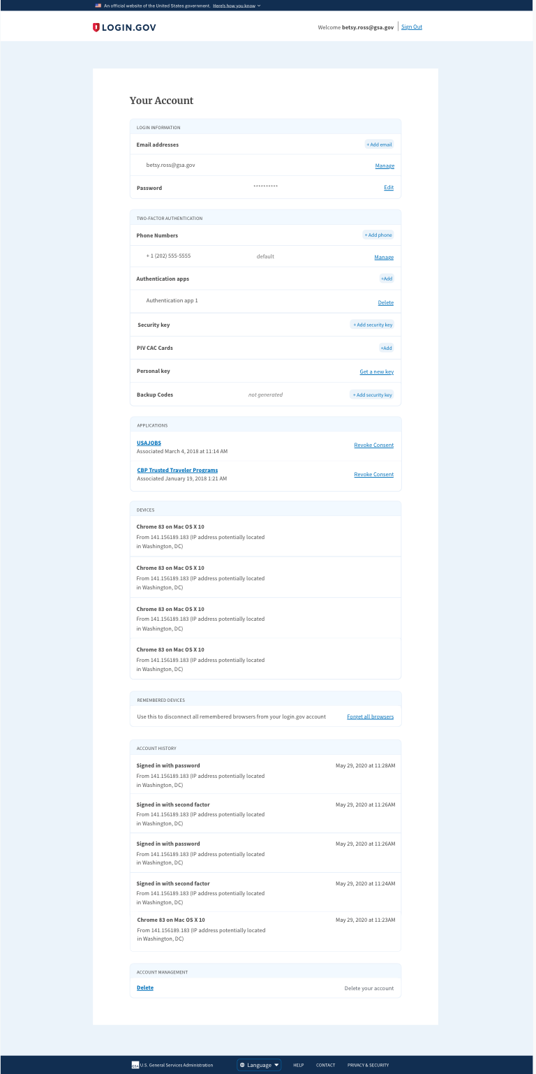
Original design
One long page with lots of content
Notes:
Where we started

Slide 13
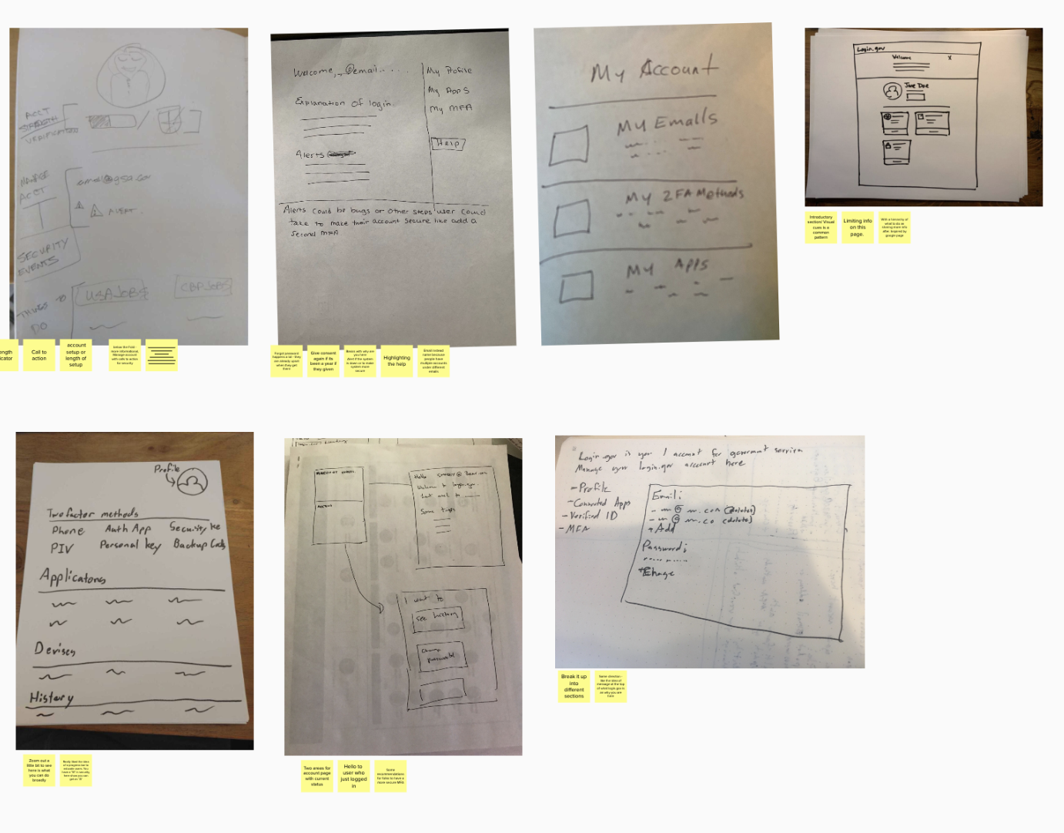
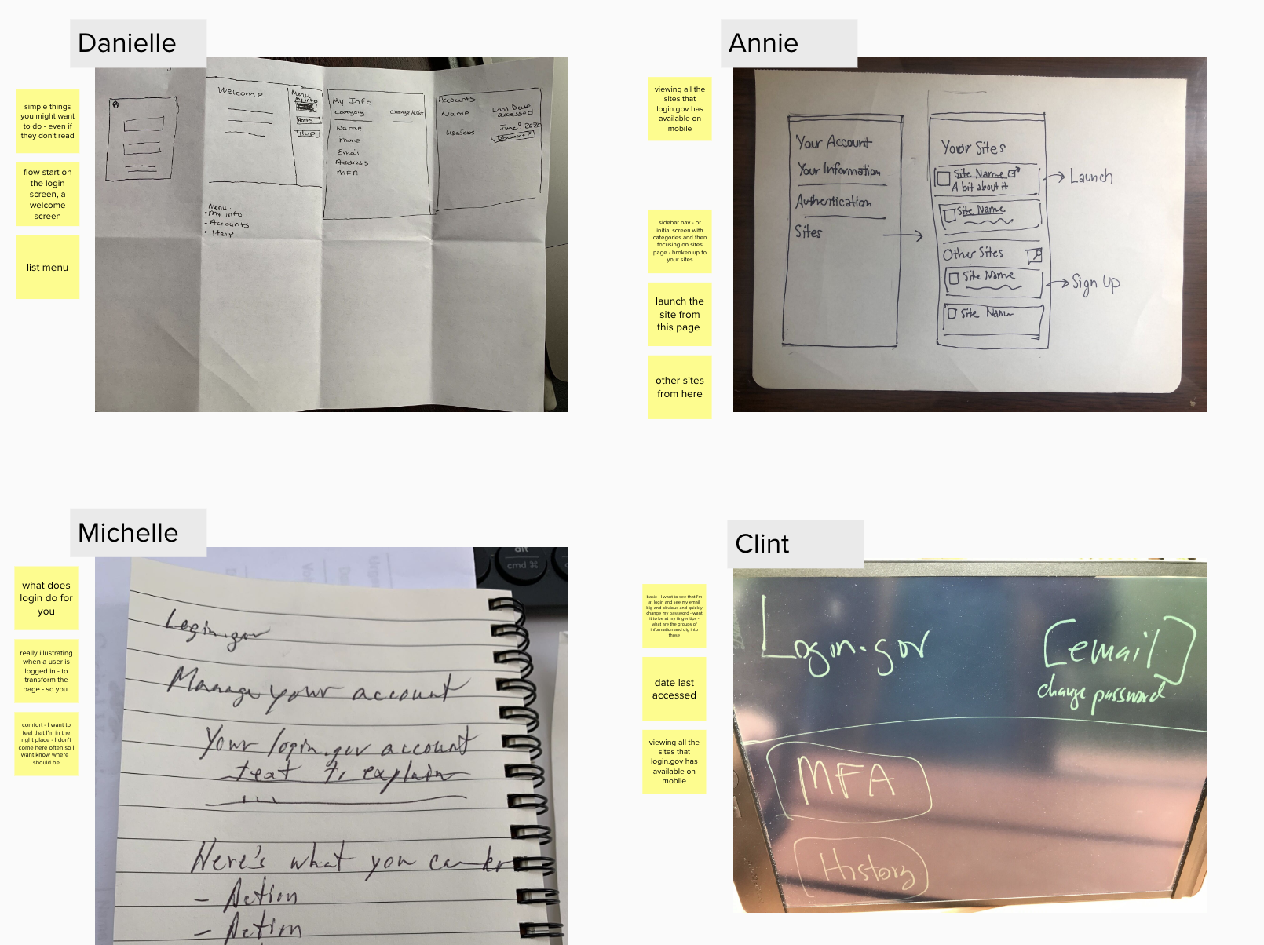
Design Studio ideas
Design Studio 2
The team brainstormed ideas over two sessions
Design Studio 1
Notes:
The team brainstormed ideas over two sessions
The questions we sought to answer with our sketches in the design studio - How might we design an experience that makes it easy for someone to understand what the login.gov account page is for and guide them to update their information?

Slide 14
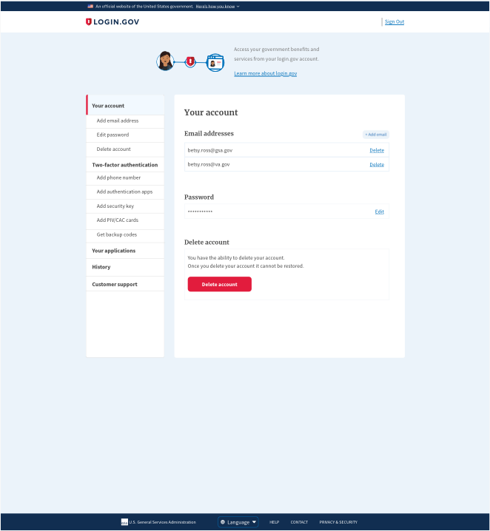
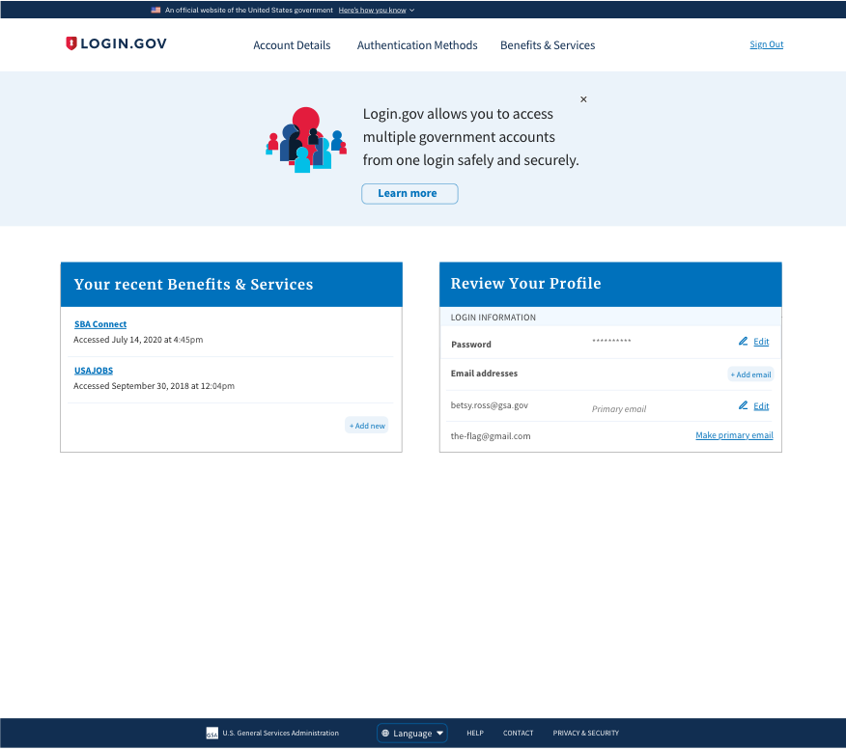
Refined design ideas
The ideas from the Design Studios were refined into Design X and Y. We shared these designs along with the original design [Design z] to all participants of our usability tests.
Design X
Design Y
Design Z
Notes:
The ideas from the Design Studios were refined into Design X and Y. We shared these designs along with the original design [Design z] to all participants of our usability tests.

Slide 15
4/ Results
Notes:
Annie, Danielle, Julia, Mitchell, Zach, Tiffany and Kenny observed and helped find patterns in behavior from our research participants. From 18F Ashley Owens and Dave Luetger also joined the sessions. Our key takeaway is that while participants liked aspects of all three designs they found it easiest to understand the purpose of the page and update their information with the side nav in Design X.
Here are some more top level insights.

Slide 16
Design Z
Half of the research participants liked the simplicity of our current design but 42% of participants felt there was too much content on the page
Notes:
People liked the simplicity of our current design but felt there was too much content for one page.
“Kinda nice having it all on one; all your information on one page. I’m seeing your account, email, looks like I have some options to update - some authentication options.”

Slide 17
“
I'd say it's slightly overwhelming. Just how all of this information, Just an initial view. It just seems like a lot to process. These should be under different categories.
”
Notes:
“(The design) was okay, but it was a little tedious going through all of (the sections of content).”

Slide 18
Design Y
42% of the participants felt it was hard to navigate but 50% liked the visual design.
Notes:
People liked how this design looked but felt it was hard to use.

Slide 19
“
This page is not nearly as accessible as (Design X). For certain things, you may not even know how to get to it.
”
Notes:
“So initial impressions is, this page is not nearly as accessible as (Design X). For certain things, you may not even know how to get to it.”
“So there's links up here. So there's nothing else on this page. I was kind of expecting it more to be on this page.”

Slide 20
Design X
50% felt that the side navigation makes it easy to know where things are located and quick to take action.
Notes:
People felt this design was easiest to understand and use.
Duplicate ways to access content from the side nav and main page makes it easy to change your information on the site.

Slide 21
“
The sidebar allowed for a very quick navigation to any section or subsection, regardless of which page you are on.
”
Notes:
“...I think it was the most efficient and it looks to me as the cleanest implementation of how the design should be laid out.”

Slide 22
Educational banner
The educational content on top of the page was helpful for people who did not understand what login.gov was.
Notes:
50% of participants commented on the design x and y which added some content explaining what what login.gov was about.
“I like how it has more of an explanation of what is at the top.”
“Clean design, banner explains what it is.”

Slide 23
“
That’s nice [sees the banner at the top of the page] because I didn't really realize login.gov was a thing, just knew I had the same login details for two sites.
”
Notes:
“I like how it has more of an explanation of what is at the top.”
“Clean design, banner explains what it is.”

Slide 24
5/ Next Steps
Notes:
Currently underway - collaboration between Ben, Julia, Mitchell and Zach to use what we learned from the research to inform an updated design that balances feature updates with difficulty of implementation.
Julia will be demoing these concepts during the demo later today.

Slide 25
Questions?

Slide 26
Resources
Account page Usability Testing Synthesis (MURAL)
Account page Research Plan
Account page Usability Testing Full Report

Slide 27
4/ Results
High level takeaways
Navigating the design
Participants liked aspects of all three designs but found it easiest to understand the purpose of the page and update their information with the side nav in Design X.

Slide 28
4/ Results
High level takeaways
Understanding the Your Account page
content which is clear to people who work in the federal government may not be understood by our users in the general public.
End Users don’t understand what different authentication methods are or what login.gov is
Notes:
“Sign in with your government employee ID” and made them question if they were in the right place
PIV/CAC confused the general public who had never heard these words which are commonplace to people in government.
Security Keys and backup codes were the methods that were understood the least. Participants commented that 2FA with sms as the authentication method they were most familiar with

Slide 29
4/ Results
Insights about the visual look and experience of navigating each design.
Design Z
Design Y
Design X

Slide 30
Who is login.gov’s End User?
At login.gov our End User is someone who needs a single signon to securely access other digital government services.

Slide 31
4/ Results
Opportunities for helpful feature additions
Educational banner
Email as account identifier

Slide 32
Email as an account identifier
Seeing email immediately allows people to understand they are in their account. This is a convention that people were expecting.
Notes:
50% commented on it when it was present in a design and its absence when it was not present.

Slide 33
“
If I see a sign out to see, like “Hi Betsy” or name signifier of some sort, (its an indication of) what am I signing out of.
”
Notes:
[Email at the top of the screen] “tells me who I am.”
“‘Welcome Betsy Ross’- Cute!” [looking at the welcome text in the upper right by the email address.]

Slide 34
4/ Results
Improving the Information Architecture
Location of Phone information
Confusion with “Applications” section title
Deleting account

Slide 35
Location of Phone information
Most people expected the Account profile to have phone number information instead of on the Authentication Page.
Notes:
75% of participants expressed this.
Opportunity to add phone #numbers to account details and SMS content on the Authentication page.

Slide 36
“
I feel like I'd want to see my phone numbers as part of my profile.
”
Notes:
It would definitely not be clear to me that I would come [to the authentication page] to change the phone number. SMS will probably be a little bit more clear. Like, that's the method. Phone number is a particular device, but not the method of authentication.

Slide 37
Confusion with “Applications” section title
58% of Participants were confused about what “Benefits & Services” or “Applications” meant.
Notes:
“Connected accounts” might be a clearer way to explain the linked accounts to other government website services.

Slide 38
“
[Benefits and services] just seems to be a weird way to word it when it's just listing when you access a website.
Did not understand what [Benefits & Services] really meant. Connected Accounts might be better.
”

Slide 39
“
[One person equated their Login profile with their USAJOBS profile and that “application” was a job application.] [Clicking] ‘Revoke Consent’ would withdraw my (job) application from consideration.
”

Slide 40
Deleting account
33% of Participants found it uncomfortable that “Delete Account” was on main pages of designs.
Notes:
We should consider making “Delete Account” accessible but less prominent.

Slide 41
“
I can also delete the entire account, although I'm not sure I would have this here. That seems a little risky. If somebody is having computer problems. I think I would hide this over on the side and just keep it here.
”

Slide 42
Each design had an obvious place to delete your account, which this user found weird.
Notes:
Observation

